Slide 1
Updated on
Hypertension in Children
Nakysa Hooman
Professor
Pediatric Nephrology
IUMS
2023

Slide 2
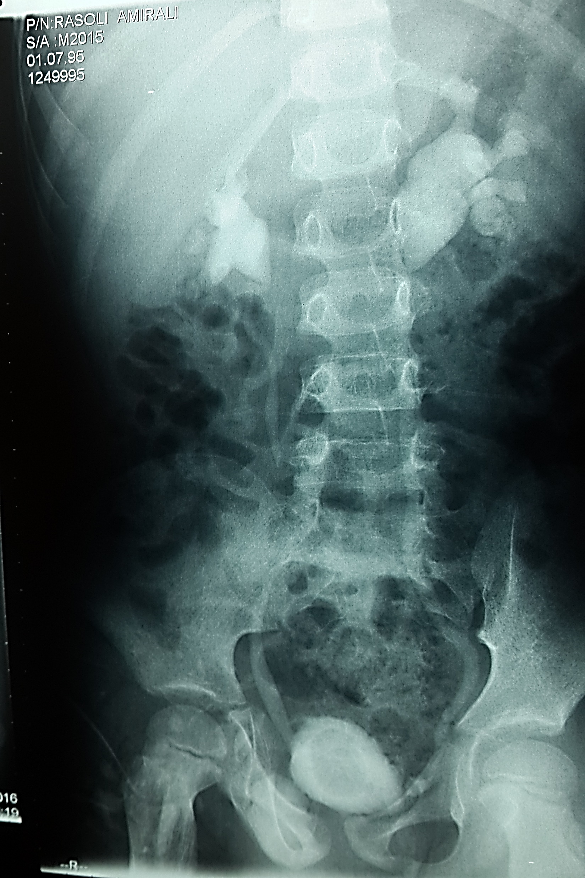
Case presentation
A 4 -yrs old boy
CC:
  Flank pain – treated and assessed by impression of UTI
RUS- thickened bladder wall
VCUG- BL VUR -GIII

Slide 3
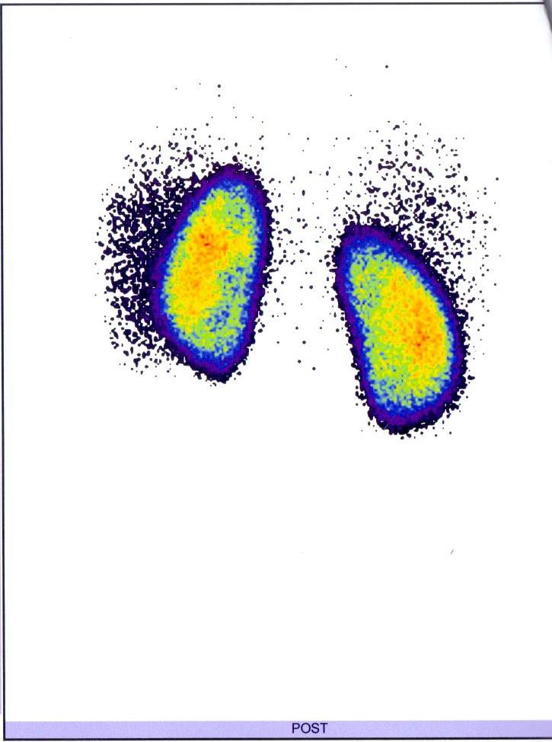
Case continued…..
  DMSA- Normal
MRI spinal column –normal

Slide 4
What age should BP measured ?
BP should be measured annually in children and adolescents ≥3 y of age.
Trained health care professionals in the office setting should make a diagnosis of HTN if a child or adolescent has auscultatory confirmed BP readings ≥95th percentile at 3 different visits.

Slide 5
Condition under which children younger than 3 yrs. should have BP measured

Slide 6
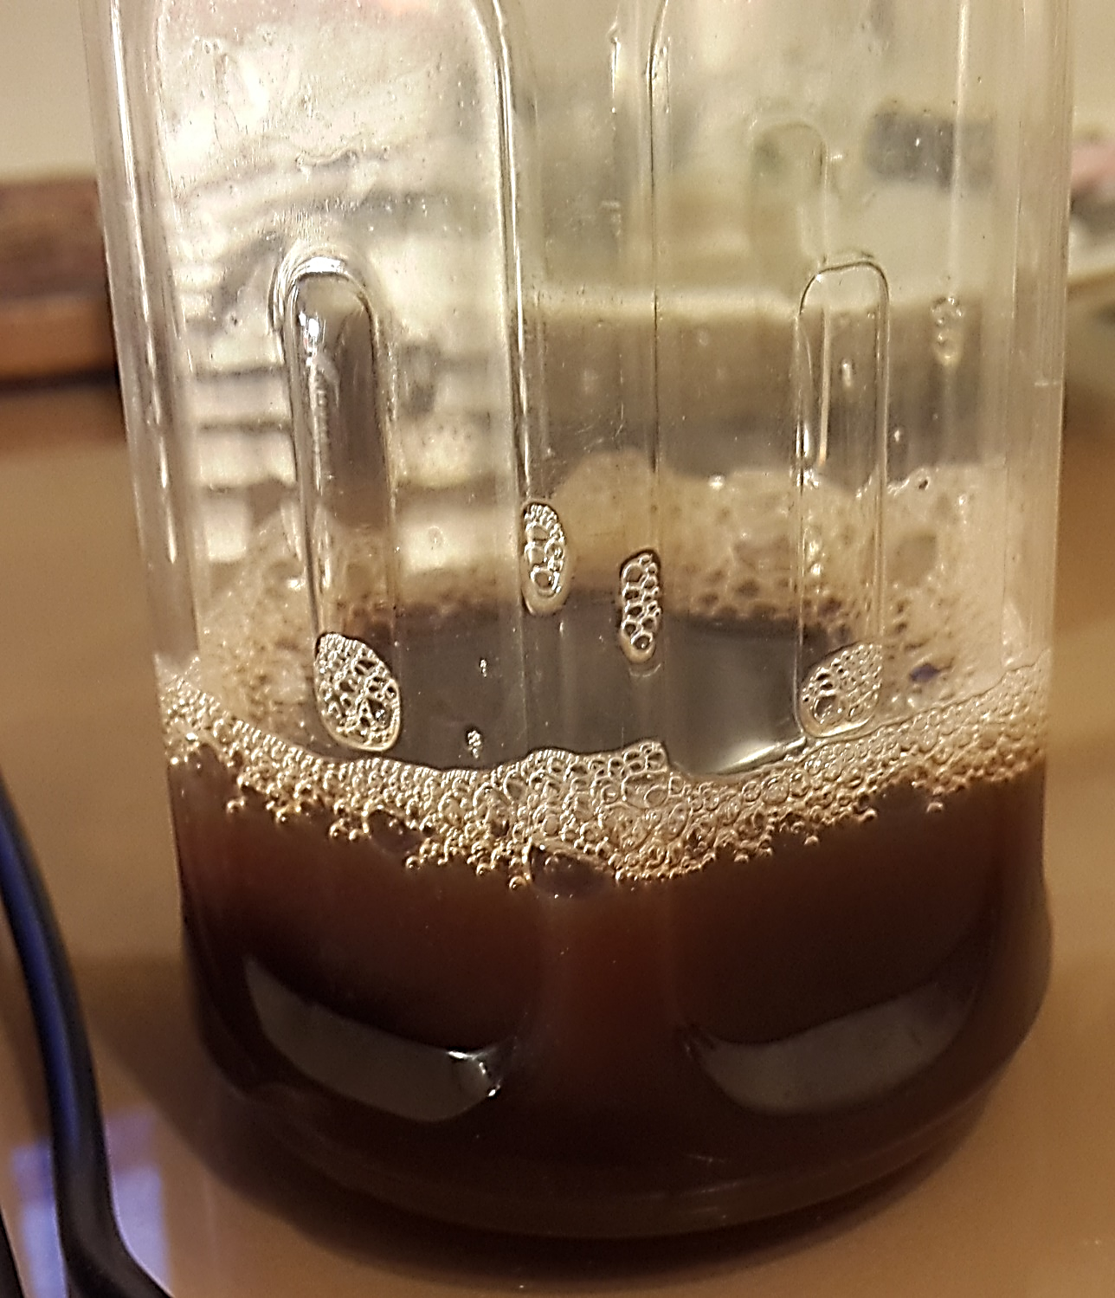
Case continued…..
A 6 -yrs. old boy
Height =113 cm
Recurrent Gross Hematuria
BP= 113/75 ( episodic)
Was blood pressure normal?

Slide 9
Case continued …
BP= 113/75
  Cut off 90% 105/66
  Cut off 95% 109/70
  Cut off 95%+12 121/81

Slide 10
Definition
PEDIATRICS Volume 140, number 3, September 2017:e20171904

Slide 11
Differential diagnosis of childhood hypertension (1)

Slide 12
Differential diagnosis of childhood hypertension (2)

Slide 13
Factors contributing the development of primary hypertension

Slide 14
Monogenic disorders of hypertension
Genetic forms of HTN stem from gain- or loss-of-function mutations
  within the mineralocorticoid, glucocorticoid, or sympathetic pathways
MG-HTN is specific genetic HTN disorders
  which inhibit Nl renal and/or adrenal BP regulation
Characterized by low plasma renin activity

Slide 15
Prevalence
  Childhood primary HTN
  North America 3.5%
  Europe 2.2-4.9%
  Iran 8.9 %
  Monogenic HTN (unknown)
  Referral outpatient clinic (>10yr) 1.8%
  Chimeric gene GRA 3.1%
  Liddle (14-40yr) 1.5%
https://doi.org/10.1186/s13293-019-0230-1

Slide 16
Classification
Excessive aldosterone synthesis
  Familial Hyperaldosteronism
Dysregulated adrenal steroid metabolism and action
  apparent mineralocorticoid excess,
  congenital adrenal hyperplasia,
  activating mineralocorticoid receptor mutation,
  primary glucocorticoid resistance
Hyperactivity of NCL transporters in the distal tubule
  Liddle syndrome
  pseudohypoaldosteronism type 2

Slide 17
When to suspect & evaluate for monogenic HTN?
Family history of early onset stroke
Resistant HTN
Hypokalemia or hyperkalemia
Metabolic acidosis or alkalosis
Abnormal history or physical exam
  history of polyuria, muscle weakness,
  Delayed or precocious puberty,
  growth failure,
  Ambiguous genitalia,
  Virilization
Exclude renovascular –HTN
Parenchymal -HTN

Slide 18
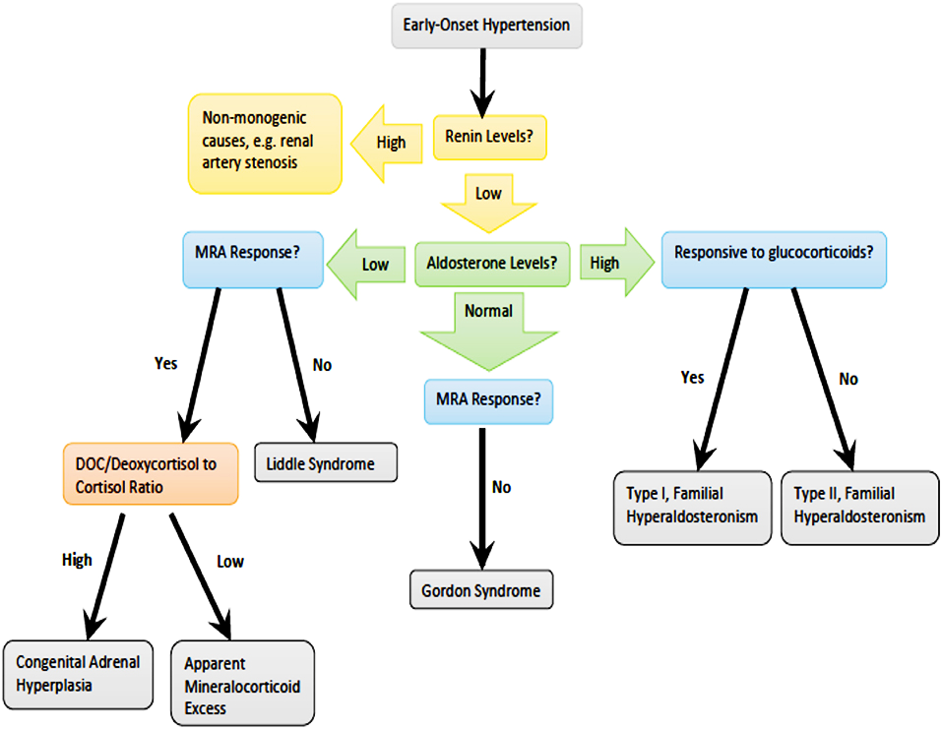
Front. Pediatr., 01 July 2019 | https://doi.org/10.3389/fped.2019.00263

Slide 20
Case continued …
Ophthalmic exam – normal
Echo- mild LVH
Colour Doppler – RI-0.7, no stenosis
Renal angiography – normal
72H- ABPM- periodic SBP/DBP hypertension

Slide 21
Abnormalities that may indicate renal artery stenosis:
Presence of a tardus et parvus (slow and small) waveform
• Renal arterial resistive index (RI) <0.55.
• Difference between right and left kidney RI values >5%.
• Acceleration time >70–80 milliseconds.
• Acceleration index (AI) <3 m/s2.

Slide 22
Case continued …
CBC- nl | Renin , Aldosterone-NL | Total protoporphirin- 585 (^)
Cr-0.3 | Pheo profile- Nl | Alpha-galactosidase-2.9(^)
Electrolyte-normal | TFT- TSH ^
 | ANA-ds-antiDNA-nl ANCA-nl IgA-nl | Kidney biopsy- inconclusive
24H urine protein –Nl | Complement –classic-nl | HUS panel- nl ,
 |  | ADMT13-nl ADAMT13-AB-29 (^)

Slide 23
Case continued …
DD
  Fabry disease
  Porphyria
  Hemolytic Uremic Syndrome
  Alport syndrome
  Familial Mediterianin Fever

Slide 24

Case continued …
Gene | Variant | zygocity
CFHR4 | HET | VUS
CFHR3 | HET | VUS
CD46 | HET | VUS

Slide 25
Summary
• Accurate measurement is very key to appropriately diagnose
hypertension.
• Be mindful of guidelines.
• Once the diagnosis is confirmed, begin with history and
physical exam.
• Treatment does not always require medication

Slide 26

Any question?

